Slide 1

Voice Conversion and Speaker Verification Using Classical Machine Learning.
Exploring the Frontiers of Audio Processing with Classical Machine Learning Techniques
Overview : This project aims to convert a given source audio to a given target audio by applying MLPG on model trained on the joint feature matrix extracted from the features of source and target audio
Dataset : "Common Voice Corpus 14.0"
Objective : To convert the source audio file to target audio file

Slide 2
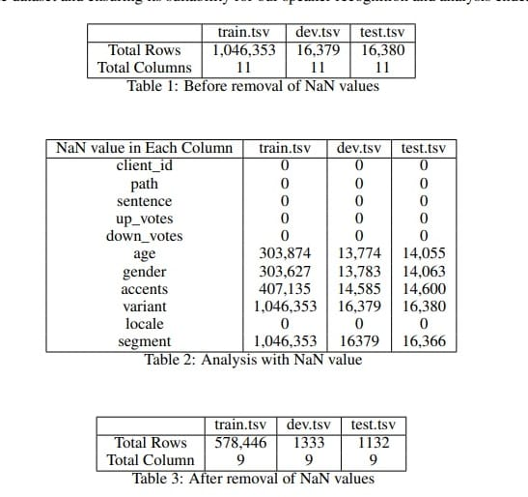
Dataset Overview and Preprocesssing.
"The 'Common Voice Corpus 14.0' comprises eight files, primarily seven tsv and one txt
Files Overview :
‘train.tsv’, ‘dev.tsv’,’test.tsv’ These files are for model development and data analysis.
‘validated.tsv’ consists valuable resource with an extensive collection of 17 Lakh rows of validated audio files for data augmentation.
Rest files are for additional information on the dataset .
.
In our data preparation process, we performed a series of essential preprocessing steps on the
66 ’train.tsv,’ ’dev.tsv,’ and ’test.tsv’ files
. Overall, these preprocessing steps were instrumental in 79 refining the dataset and ensuring its suitability for our speaker recognition and analysis endeavors.

Slide 3
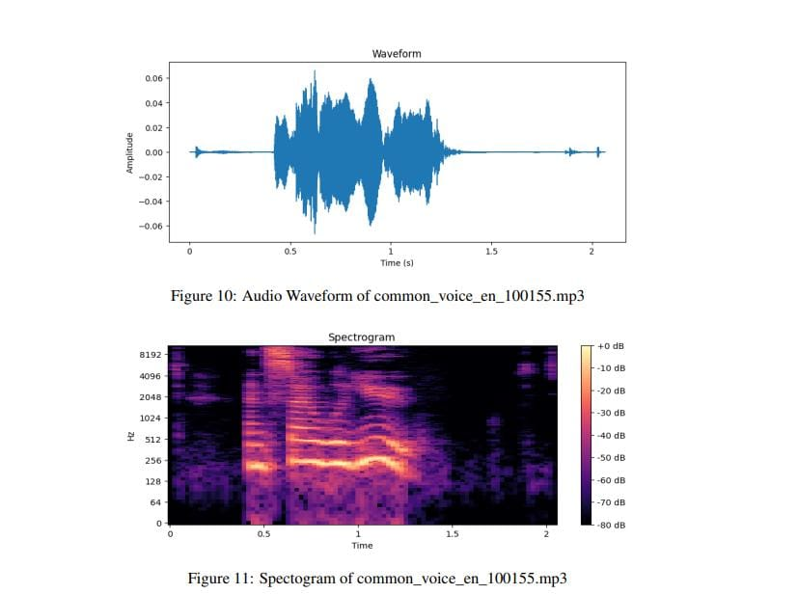
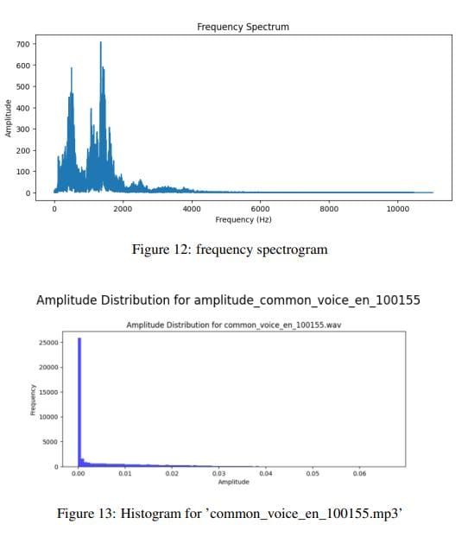
VISUALIZATION
Waveforms & Spectrogram analysis
The total number of files in our dataset is 1503676. To ease out the visualization, we have loaded 20 files from the dataset for the analysis.Among the 20 audio files,we selected one file "common_voice_en_100155.mp3" and performed visualization analysis

Slide 4
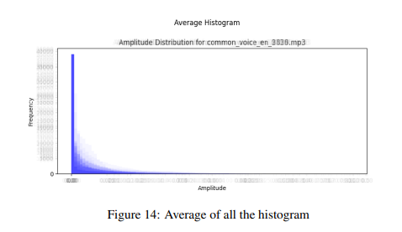
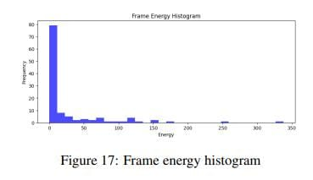
Amplitude distribution using histogram
"Histograms of audio signals are valuable for discerning amplitude distribution, shedding light on critical audio characteristics.
Average of all the histograms of all 20 files
Frame Energy Histogram

Slide 5
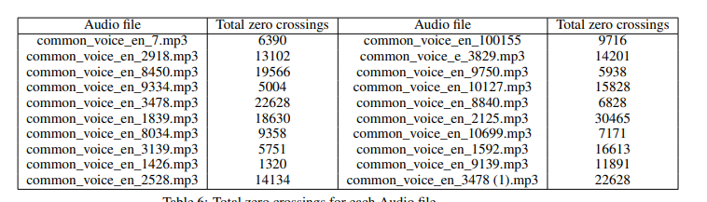
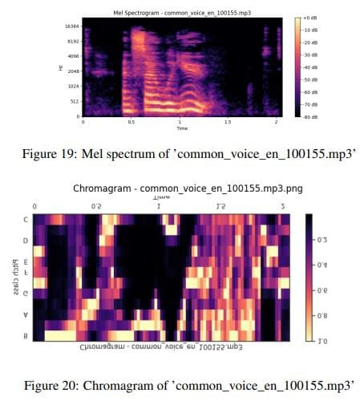
Zero Crossing Rate Analysis
Zero crossing rate quantifies the rate of sign changes in an audio signal, useful for characterizing noisiness or percussiveness. The total zero crossings for each audio file are listed in Table 6,The average zero crossing rate is 1028.55
Chromagram and Mel Spectrogram Analysis
Chromagrams visually represent energy distribution across musical pitch classes, offering insights into pitch, harmonic content, and musical structure [Fig.20]. Mel spectrograms emphasize human pitch perception and are crucial for speech and music analysis [Fig.19].

Slide 6
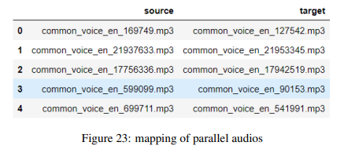
Feature Extraction for Voice Conversion
Source to Target Mapping:
The initial step involves mapping source to target MP3 audio files. This process included the extraction of MP3 audio files from the top 100 client IDs in the ’train.tsv’ dataset. For conversion, we have considered 20 files, and made the source-target pairs of the parallel audios. We have mapped these parallel audios and saved them for reuse in "mapping_df.pkl"
Feature Extraction
Features that are extracted are:
Prosodic Features: Capturing variations in pitch, duration, rhythm.
MFCC features
Supra-Segmental Features: Modifying elements like stress, prosody, and speaking rate, influencing expressive qualities of speech
Extracted features are extracted for source and target audio, organized into tuples, and stored for future analysis. This structured approach ensures the relationship between source and target data remains intact

Slide 7
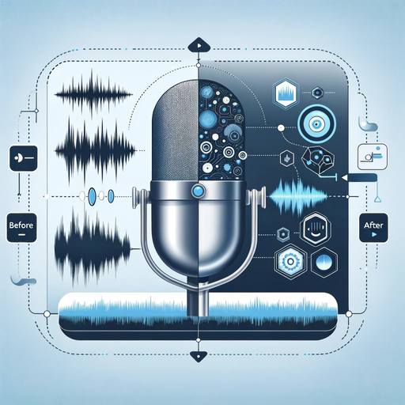
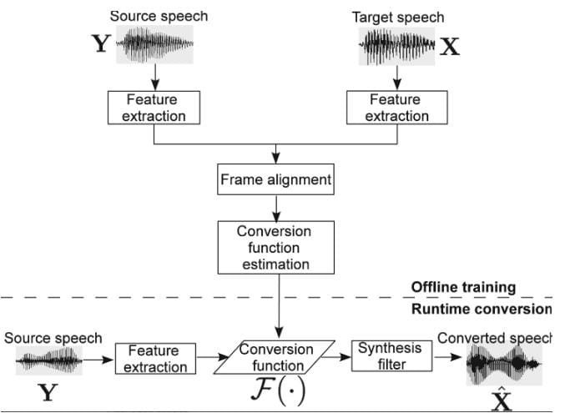
Voice Conversion Techniques
Voice conversion is a technique that transforms a person’s voice to sound like another while preserving linguistic content. Key characteristics include language content, spectral patterns, and prosody—contributing to the uniqueness of the human voice.
Pipeline followed
During training, features characterizing speaker identity are paired between source and target. At runtime, a learned conversion function is applied to source features for generating converted speech.

Slide 8
Conclusion and Future Strategy
This project explored the significance of voice conversion in speech processing, authentication, and human-computer interaction. Detailed analysis of the 'Common Voice Corpus 14.0' dataset provided valuable insights into demographic diversity, linguistic characteristics, and audio content.
Thus using the pipeline a given source audio is getting converted to target audio

Slide 9
Thank you!
Team 31

